Slide 1

Spam mail classifier
Team 3 - Kunal Chugh & Vighnesh Venkatakrishnan

Slide 2
Project summary
Our objective was to detect whether an email was spam or not
Dataset involved details of sender, receiver, email body and subject, message id, xuidl and a lot of other fields in text files
We divided the project into 3 parts – structuring data, exploratory data analysis and feature extraction/training testing data
We used Google colab to run our notebooks and achieved up to 72% accuracy for classifying spam emails correctly.

Slide 3
Project Implementation
Github repo link : https://github.com/kunalchugh91/INFO6101-Spam-Classifier
Packages/Modules needed to run this project are: nltk, wordcloud, xlrd, numpy, pandas, spark, xlsxwriter, BeautifulSoup, matplotlib, findspark, scikit-learn.
The datasets for this project can be downloaded from the below links:
1. 1998 dataset - https://drive.google.com/open?id=1QtoxpJmd1lys7c7LaYXiOjbzMdMOpeVX
2. trec07p dataset - https://drive.google.com/open?id=1xaJL1eoccrCyS45xgF23dVY_KCER-oAD

Slide 4
Part – 1 – Structuring data
Parsed unstructured text files into list of email header : value pairs.
File encoding issues : utf-8 and ISO-8859-1
New line is a new key value pair? (colon is within first 30 chars, first letter is capital, no space in header, create list “notHeader”, hold value in temp variable)
Many email text files contained duplicate fields. Removed such redundant fields.
Many email body fields contained HTML content. Used BeautifulSoup to get visible text from such HTML content.
Store everything in a pandas dataframe and excel file

Slide 5
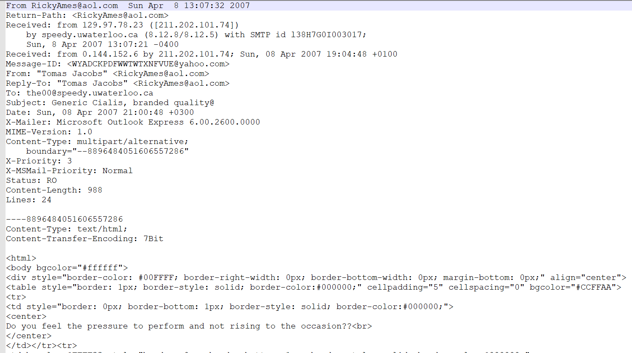

Slide 6
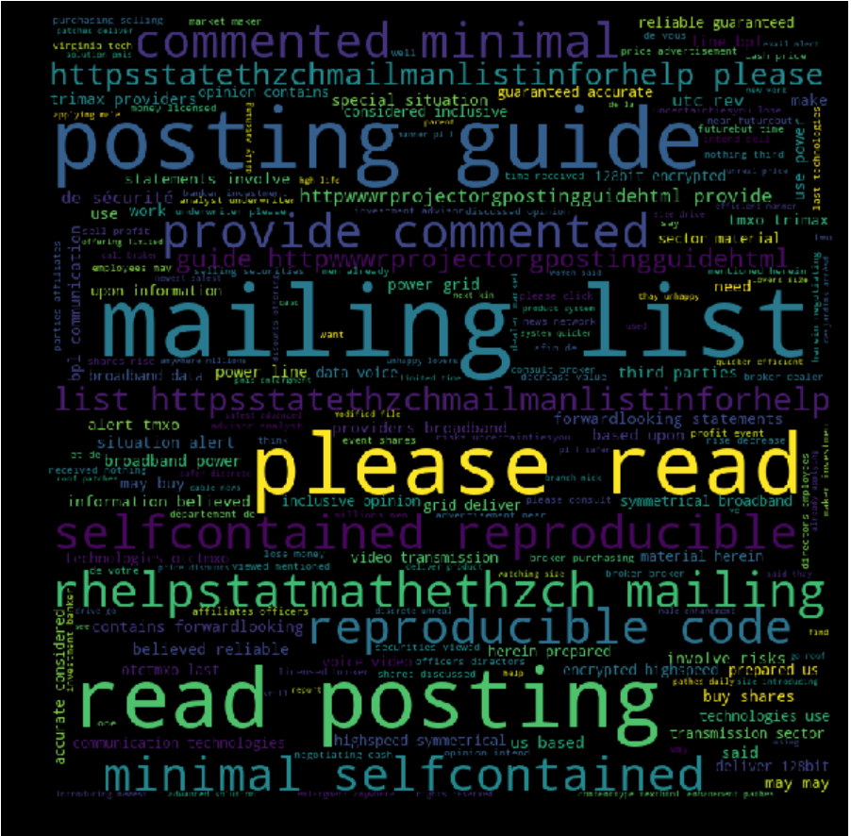
Part – 2 – Exploratory data analysis
The purpose of this notebook is to explore the data and find out key features that identify whether an email is spam or not
Used NLTK for data preprocessing of the body – regex clean, tokenize, stem, stopword removal and generated a wordcloud
Words like mailing, list, retail, price, per, item, posting are frequently found in spam emails. They indicate that the spammer wants to sell an item or send spams after user is subscribed to a mailing list or job posting.

Slide 7
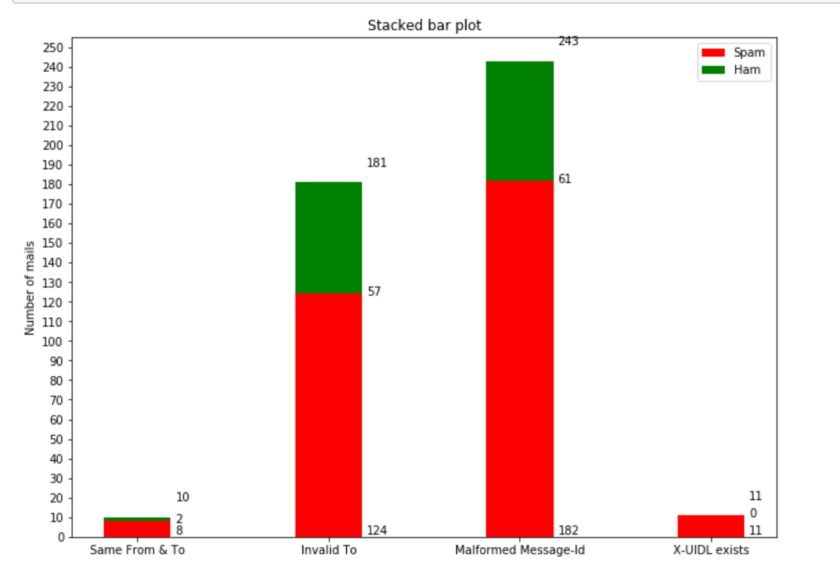
Part – 2 – Exploratory data analysis
Feature 1 : from field == key field
Feature 2 : invalid email format of recipient(in to field, not bcc)
Feature 3 : malformed message id (<>\n)
Feature 4 : X-UIDL is not empty(mailserver keeps receiving multiple copies)

Slide 8
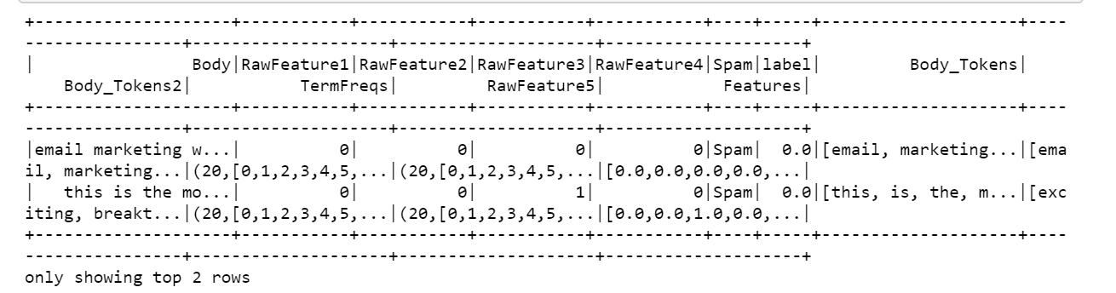
Feature 5 – TFIDF engineering
Used spark to create body tokens, generate tf and calculate tf-idf
Transform our train dataset to extract features (4 mentioned earlier and TFIDF) using pyspark and train a Multinomial Naive Bayes model
Used Spark Vector Assembler to combine all raw features into one feature vector

Slide 9
Part 3 - feature extraction, training, prediction
Partition dataset randomly into train-test splits (75-25)
Attempted to calculate percentage of misspelled words as our 6th feature, but did not use it
Used feature vector from Vector assembler to fit on Multinomial NaïveBayes model
Used the test dataset to calculate the accuracy of our prediction.

